Slide 1
Software Process and Process Models
Session 02
Course : Software Engineering
Effective Period : Desember 2017

Slide 2
These slides have been adapted from
Pressman, R.S. (2015). Software Engineering : A Practioner's Approach. 8th ed. McGraw-Hill Companies.Inc, Americas, New York. ISBN : 978 1 259 253157. Chapter 3 and 4
Acknowledgement

Slide 3
LO 1 : Describe the concepts of software process models
Learning Objectives

Slide 4
Contents
Generic Process Model
Process Assessment and Improvement
Prescriptive Process Models
Specialized Process Models
Personal Software Process (PSP)
Team Software Process (TSP)
Game Development Life Cycle (GDLC)

Slide 5

Generic Process Model

Slide 6
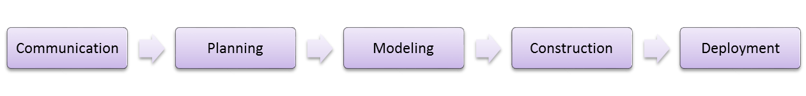
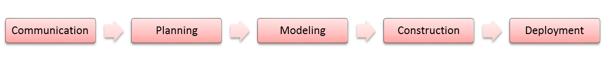






Generic Process Model
Process Flow
(a) Linear Process Flow
(b) Iterative Process Flow
(c) EvolutionaryProcess Flow
Increment released

Slide 7
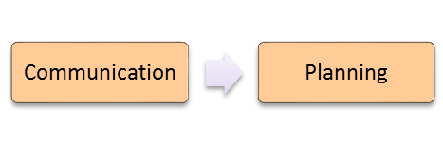




Generic Process Model
Process Flow
(d) Parallel Process Flow
Time

Slide 8
Generic Process Model
Identifying a Task Set
A task set defines the actual work to be done to accomplish the objectives of a software engineering action.
  A list of the task to be accomplished
  A list of the work products to be produced
  A list of the quality assurance filters to be applied

Slide 9
Generic Process Model
Process Patterns
A process pattern
  describes a process-related problem that is encountered during software engineering work,
  identifies the environment in which the problem has been encountered, and
  suggests one or more proven solutions to the problem.
Stated in more general terms, a process pattern provides you with a template [Amb98]—a consistent method for describing problem solutions within the context of the software process.

Slide 10
Generic Process Model
Process Pattern Types
Stage patterns—defines a problem associated with a framework activity for the process.
Task patterns—defines a problem associated with a software engineering action or work task and relevant to successful software engineering practice
Phase patterns—define the sequence of framework activities that occur with the process, even when the overall flow of activities is iterative in nature.

Slide 11
Process Assessment and Improvement
Standard CMMI Assessment Method for Process Improvement (SCAMPI) — provides a five step process assessment model that incorporates five phases: initiating, diagnosing, establishing, acting and learning.
CMM-Based Appraisal for Internal Process Improvement (CBA IPI)—provides a diagnostic technique for assessing the relative maturity of a software organization; uses the SEI CMM as the basis for the assessment [Dun01]
SPICE—The SPICE (ISO/IEC15504) standard defines a set of requirements for software process assessment. The intent of the standard is to assist organizations in developing an objective evaluation of the efficacy of any defined software process. [ISO08]
ISO 9001:2000 for Software—a generic standard that applies to any organization that wants to improve the overall quality of the products, systems, or services that it provides. Therefore, the standard is directly applicable to software organizations and companies. [Ant06]

Slide 12
Prescriptive Process Models
Prescriptive process models advocate an orderly approach to software engineering
That leads to a few questions …
If prescriptive process models strive for structure and order, are they inappropriate for a software world that thrives on change?
Yet, if we reject traditional process models (and the order they imply) and replace them with something less structured, do we make it impossible to achieve coordination and coherence in software work?

Slide 13
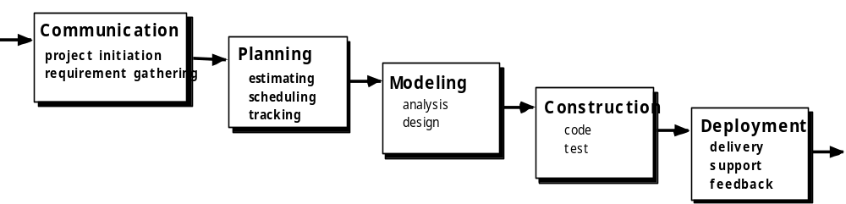
Prescriptive Process Models
The Waterfall Model

Slide 14

Prescriptive Process Models
The V-Model

Slide 15
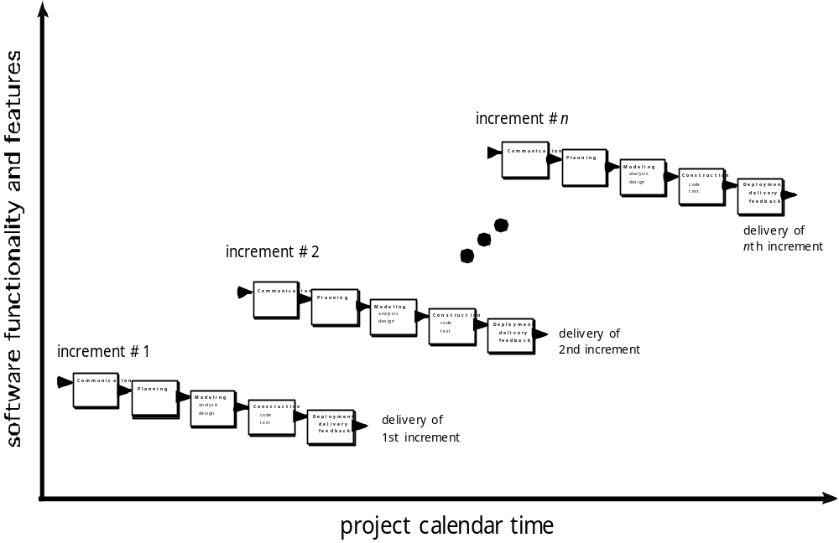
Prescriptive Process Models
The Incremental Model

Slide 16

Prescriptive Process Models
Evolutionary Models: Prototyping
Quick
plan
communication
Modeling
Quick design
Deployment
delivery &
feedback
Construction
of prototype
Construction
of prototype

Slide 17
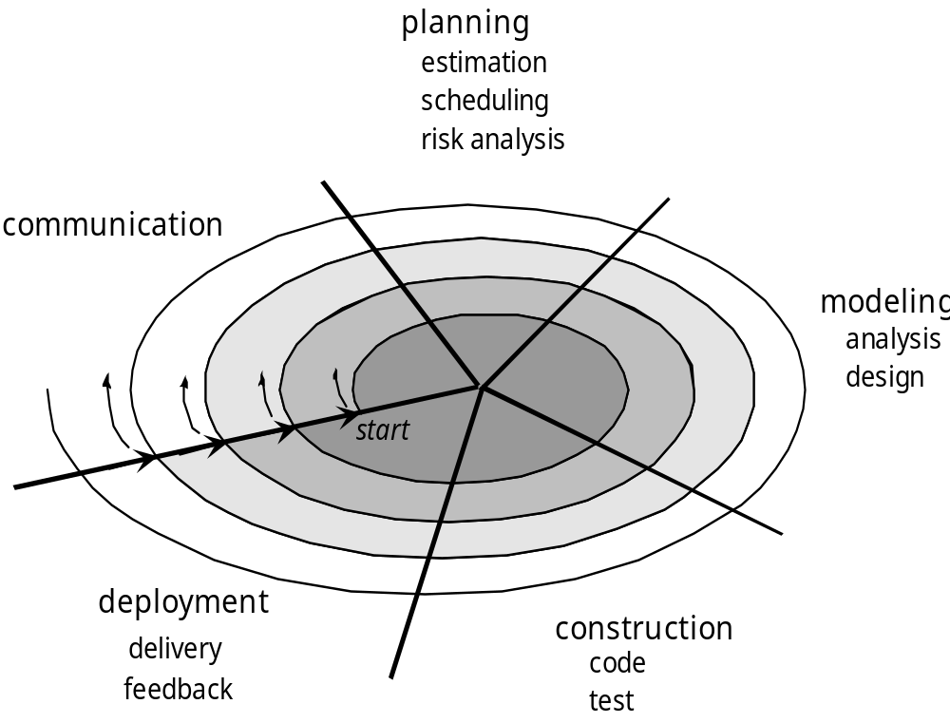
Prescriptive Process Models
Evolutionary Models: The Spiral

Slide 18
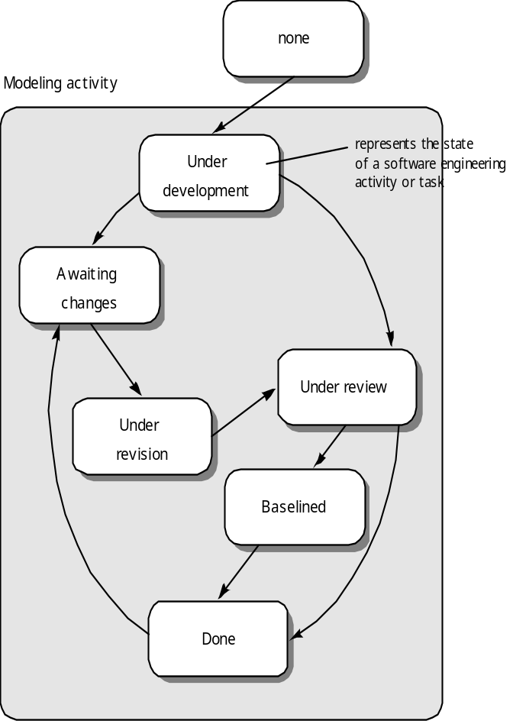
Prescriptive Process Models
Evolutionary Models: Concurrent

Slide 19
Specialized Process Models
Component based development—the process to apply when reuse is a development objective
Formal methods—emphasizes the mathematical specification of requirements
AOSD—provides a process and methodological approach for defining, specifying, designing, and constructing aspects
Unified Process—a “use-case driven, architecture-centric, iterative and incremental” software process closely aligned with the Unified Modeling Language (UML)

Slide 20

Specialized Process Models
The Unified Process (UP)
elaboration
inception

Slide 21
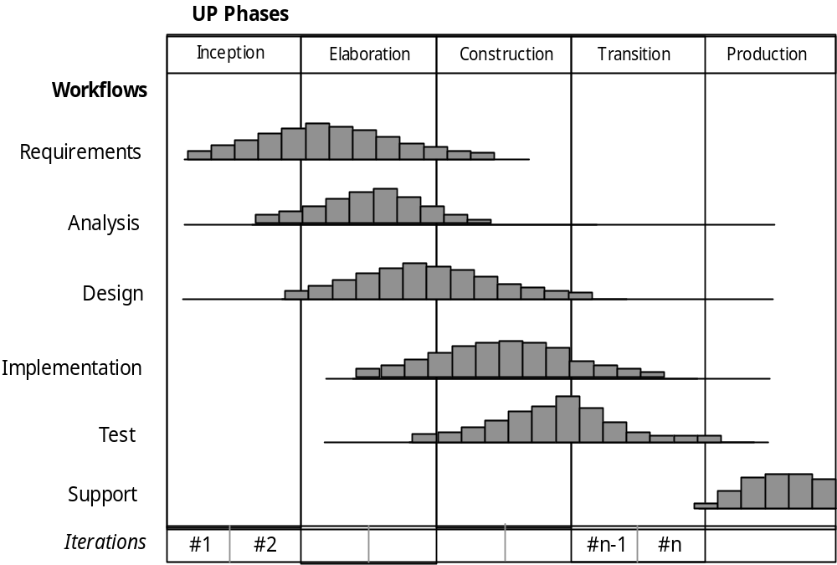
Specialized Process Models
UP Phases

Slide 22
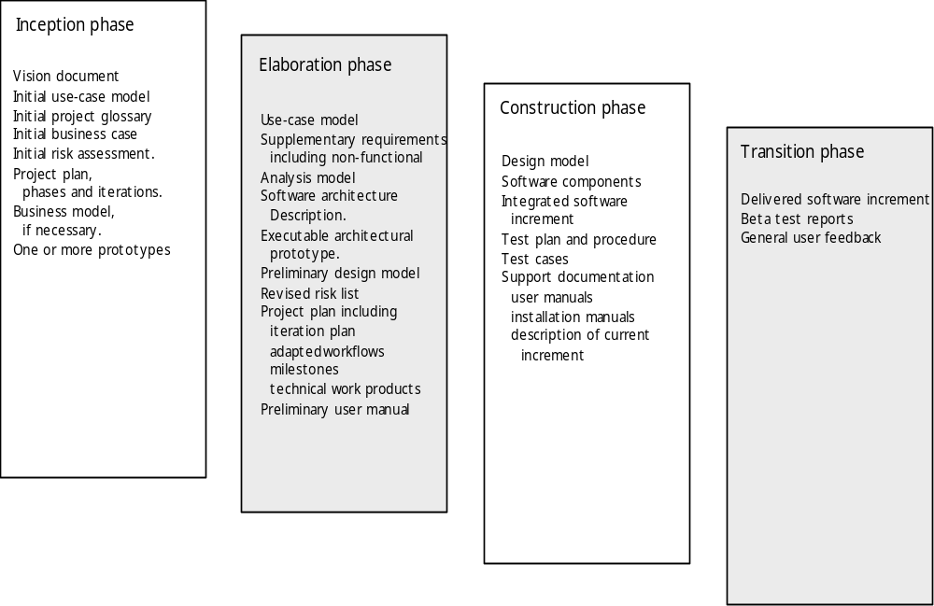
Specialized Process Models
UP Work Products

Slide 23
Personal Software Process (PSP)
Planning. This activity isolates requirements and develops both size and resource estimates. In addition, a defect estimate (the number of defects projected for the work) is made. All metrics are recorded on worksheets or templates. Finally, development tasks are identified and a project schedule is created.
High-level design. External specifications for each component to be constructed are developed and a component design is created. Prototypes are built when uncertainty exists. All issues are recorded and tracked.
High-level design review. Formal verification methods (Chapter 21) are applied to uncover errors in the design. Metrics are maintained for all important tasks and work results.
Development. The component level design is refined and reviewed. Code is generated, reviewed, compiled, and tested. Metrics are maintained for all important tasks and work results.
Postmortem. Using the measures and metrics collected (this is a substantial amount of data that should be analyzed statistically), the effectiveness of the process is determined. Measures and metrics should provide guidance for modifying the process to improve its effectiveness.

Slide 24
Team Software Process (TSP)
Build self-directed teams that plan and track their work, establish goals, and own their processes and plans. These can be pure software teams or integrated product teams (IPT) of three to about 20 engineers.
Show managers how to coach and motivate their teams and how to help them sustain peak performance.
Accelerate software process improvement by making CMM Level 5 behavior normal and expected.
  The Capability Maturity Model (CMM), a measure of the effectiveness of a software process, is discussed in Chapter 30.
Provide improvement guidance to high-maturity organizations.
Facilitate university teaching of industrial-grade team skills.

Slide 25
Game Development Life Cycle (GDLC)
According to Pressman, game is a kind of software which provides entertainment
However, game development using only software development life cycle (SDLC) faces several challenges
While SDLC is a systematical process of engineering to develop software, game is not purely a product of pure engineering
Game also is not just pure art, a creation of creativity and imaginative thinking, but game is more like a craft, created from the combination of interleaving, multidiscipline aspect, from art, music, programming, acting, and the management and integration of those aspects
Therefore, a game development requires specific guidelines which govern its development process, the game development lifecycle (GDLC)

Slide 26

Blitz Games Studios GDLC
Blitz Games Studios defines six steps of their GDLC.
A game development is started from pitch (1) to create the initial design and game concept.
After the concept is made, it is refined through the pre- production (2), in which the game design, concept art, and the game design document is made
The realization of the concept is done through the main production (3) process.
Through a lengthy process of main production, the game build then is tested by internal team members, called alpha (4) testing
When the build has satisfied the needs of alpha testing, a next phase testing called beta (5) testing is conducted to the third party tester
The game is launched in master (6) phase.

Slide 27

Arnold Hendrick’s GDLC
Arnold Hendrick defines five steps of developing a game
Starting point of creating a game is to create the initial design, concept arts, and several prototype in prototype (1) phase.
The next step, pre-production (2), is to make the documentation in a form of game design document.
Production (3) is related to the construction of assets, source code, and the integration of those aspects.
When the build is ready, beta(4) testing is conducted to draw users’ feedback.
Live(5) is when the game has already been pass the testing and ready to play.

Slide 28

Doppler Interactive GDLC
Joshua McGrath from Doppler Interactive defines seven steps in game development process
Design (1) is related to the creation of game initial design and the game design document.
After the design is ready, start develop a game engine for current game in develop (2) phase, then test it out in evaluate (3) phase.
If the build is not satisfying, redevelop (2) it.
If it passes the evaluation, advance to test (4) phase to test the game to the internal team and doing the bug fixing.
After that, the game is released to the third party in review release (5).
Repeat the whole process from (1) to (5) until the game is ready to launch in release (6) phase

Slide 29
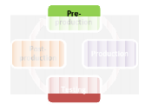
Heather Chandler’s GDLC
Heather Chandler defines the four steps in game development process
A game development consists of several production cycle started from pre-production (1) which defines game design and project planning.
After the design and plan has been fixed and approved, it is time move into action to production (2) which is related to creation of both technical and artistic aspects.
Then, test (3) the game and fix the bugs.
When a build is considered finished for a single cycle, post- production (4) is conducted to deliver the current documentation and post-mortem activities

Slide 30
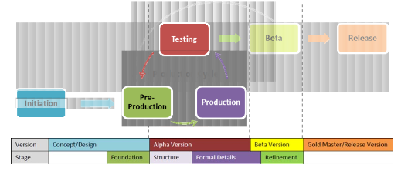
THE PROPOSED GDLC
(Rido Ramadan and Yani Widyani)
1. The proposed GDLC is developed from the analysis of the above methods and derived from the key activities in the relevant GDLC phases.
2. The proposed GDLC applies an iterative approach to enable higher degree of flexibility towards changes during game development.
3. The proposed GDLC is created to address the quality criteria of each prototype stage in order to maintain the quality of the final product.

Slide 31
References
Pressman, R.S. (2015). Software Engineering : A Practioner's Approach. 8th ed. McGraw-Hill Companies.Inc, Americas, New York. ISBN : 978 1 259 253157.
Software Process Models, http://www.google.com/search?q=software+process+models&hl=en&tbm=isch&tbo=u&source=univ&sa=X&ei=Ha54UZuAFYb3rQeWlIGYAg&sqi=2&ved=0CEwQsAQ&biw=1080&bih=653
Applying UML in the Unified Process, http://www.jeckle.de/files/uniproc.pdf‎

Slide 32
Q & A

